Slide 1
4CS015 Lecture 5: Sequential Logic and Memory

Slide 2
The story so far
We’ve looked Number System.
We’ve learned conversion of Number System.
We’ve looked at combinational logic circuits.
We’ve designed an ALU from logic gates.
1.The story so far
2.This week will look at
3.The next step
4.Combinational vs. Sequential

Slide 3
This week we will look at:
Sequential Logic
Pulses and clocks
Timing Diagram
Race Hazard
Flip-Flop
1.The story so far
2.This week will look at
3.The next step
4.Combinational vs. Sequential

Slide 4
The next step
An ALU without any way of running a programme or storing information is just a calculator
What we are going to looked at now, is how logic circuits work with time and what the implications are.
1.The story so far
2.This week will look at
3.The next step
4.Combinational vs. Sequential

Slide 5
Combinational vs. Sequential
Combinational Logic
The output of the logic circuit is a function of the inputs
Think ‘OR’ gate
Sequential Logic
The output of the circuit is a function of the current inputs and the previous output state
To accomplish this, the circuit needs to remember what the previous state was
i.e. It needs memory!
1.The story so far
2.This week will look at
3.The next step
4.Combinational vs. Sequential

Slide 6
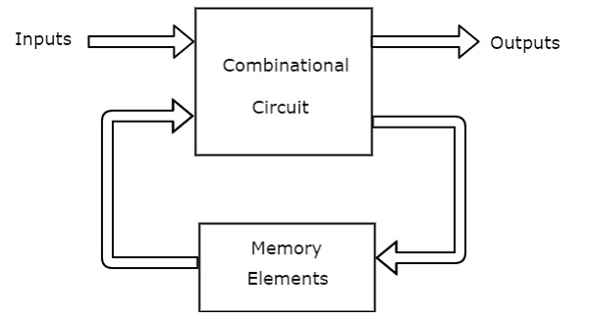
Sequential logic
Creation of memory from Logic.
By looking at the output of the last logic state.
Modifying new logic state based on what went on before.
1.The story so far
2.This week will look at
3.The next step
4.Combinational vs. Sequential
4.1 Sequential logic
Fig: block diagram of sequential circuit

Slide 7
Timing Diagram
To show what goes on in a logic circuit over time, we use Timing Diagrams
A Timing diagram is a Picture of the effect of a Wave Form, passing through a Logic Gate.
The changes of a logic input signal with respect to time.
5.Timing Diagram
5.1 Timing Example- A Pulse
5.2 A Clock
5.3 Nano seconds
5.4 Timing Diagram for AND Gate

Slide 8
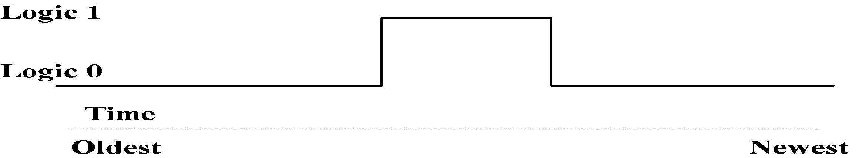
Timing Example – A Pulse
5.Timing Diagram
5.1 Timing Example- A Pulse
5.2 A Clock
5.3 Nano seconds
5.4 Timing Diagram for AND Gate
The signal level is at a logical 0 before the pulse.
It then rises to a logical 1 at the rising edge.
It stays at a logical 1 for a period of time (the pulse duration).
It then falls back to a logical 0 the falling edge.

Slide 9
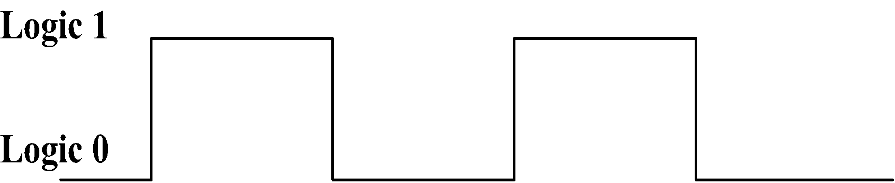
A Clock
A clock has a repeating wave form (or pulse).
The period of a clock is measured from one rising edge to the next rising edge.
The frequency of the clock is the number of complete periods in a Second. (Hz).
The pulses of a CPU clock control its operation.
i.e. A Clock Synchronises Operations in CPU.
5.Timing Diagram
5.1 Timing Example- A Pulse
5.2 A Clock
5.3 Nano seconds
5.4 Timing Diagram for AND Gate

Slide 10
Nanoseconds
The timing diagrams show time to any level.
If the clock waveform on the previous slide was for an Intel Pentium 3.2, the diagram would show 1.56 X 10⁻⁹ seconds (1.56 nanoseconds)
A typical TTL logic gate takes up to 4 Nanoseconds to go from 0 to 1.
5.Timing Diagram
5.1 Timing Example- A Pulse
5.2 A Clock
5.3 Nano seconds
5.4 Timing Diagram for AND Gate

Slide 11
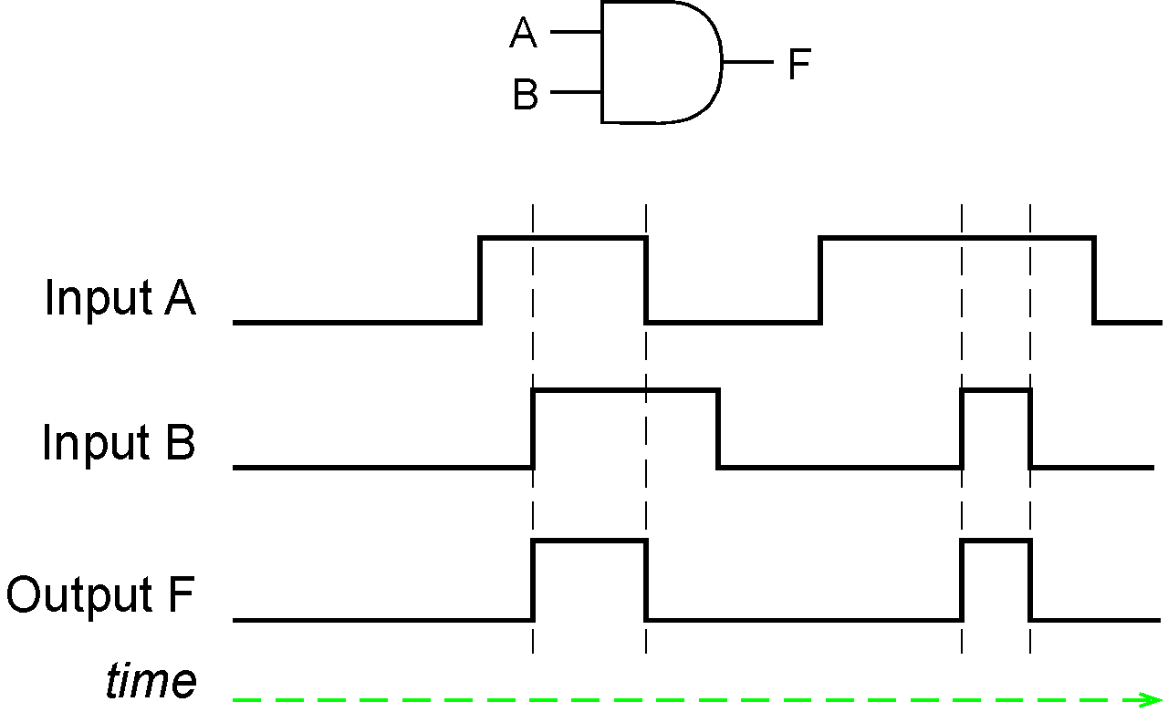
Timing Diagram for AND Gate
5.Timing Diagram
5.1 Timing Example- A Pulse
5.2 A Clock
5.3 Nano seconds
5.4 Timing Diagram for AND Gate

Slide 12
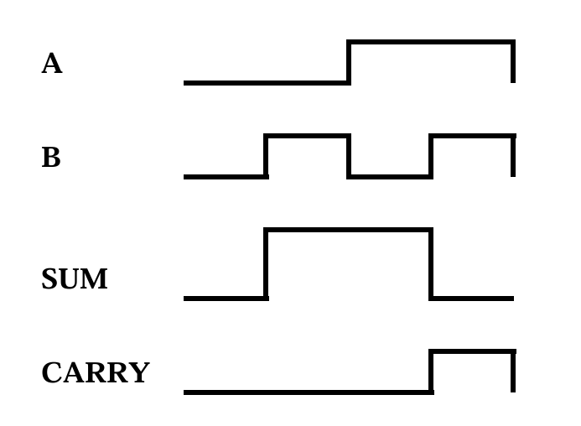
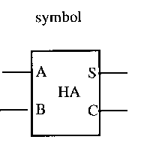
Timing Diagram for HALF ADDER
5.Timing Diagram
5.1 Timing Example- A Pulse
5.2 A Clock
5.3 Nano seconds
5.4 Timing Diagram for AND Gate
5.5 Timing Diagram for Half Adder
5.6 Timing Diagram for Full Adder

Slide 13
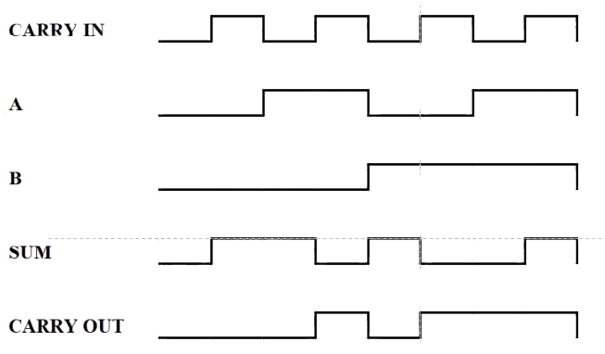
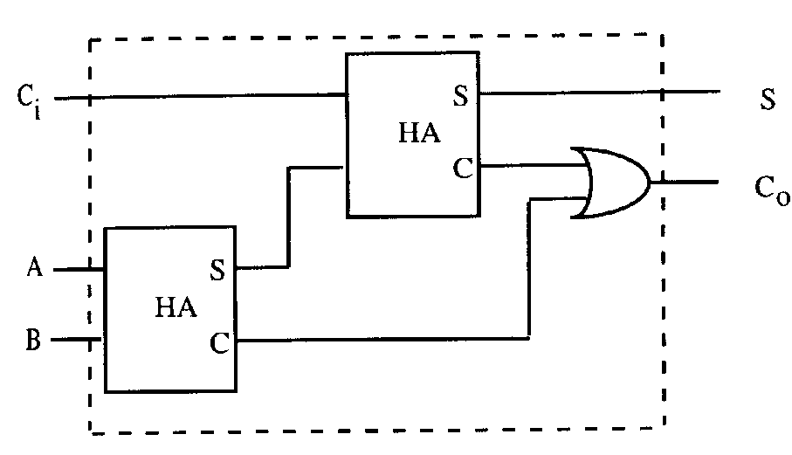
Timing Diagram for FULL ADDER
5.Timing Diagram
5.1 Timing Example- A Pulse
5.2 A Clock
5.3 Nano seconds
5.4 Timing Diagram for AND Gate
5.5 Timing Diagram for Half Adder
5.6 Timing Diagram for Full Adder

Slide 14
Race Hazard
A race hazard occurs when an unintended spike (very short pulse ~4 to 10 nano seconds) causes an unexpected and undesired change of output to occur
Output should always theoretically be 0 (Boole’s Law), but transition time can cause a spike
6. Race Hazard
7. An Interesting Circuit
8. Simple Memory Block
A
B
A
O/P
B

Slide 15
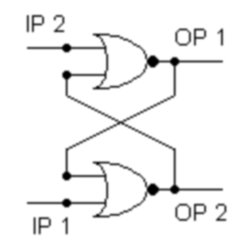
An Interesting Circuit
What do you think this circuit does?
6. Race Hazard
7. An Interesting Circuit
8. Simple Memory Block
NOR Truth Table
A | B | O/P
0 | 0 | 1
0 | 1 | 0
1 | 0 | 0
1 | 1 | 0

Slide 16
An Interesting Circuit
NOR Truth Table
6. Race Hazard
7. An Interesting Circuit
8. Simple Memory Block
1
A | B | O/P
0 | 0 | 1
0 | 1 | 0
1 | 0 | 0
1 | 1 | 0
0
0
?
1
1
0
?
0
1
?
0
?
1
1
0
13

Slide 17
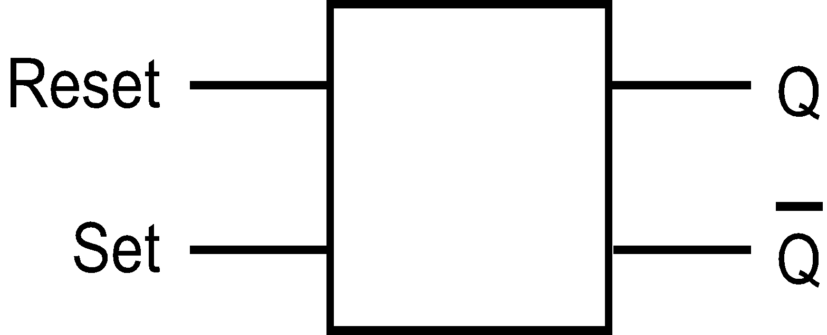
Simple Memory Block
Initially Set and Reset are at Logic 0
Output at this point are not known.
Putting a pulse on the Set input causes the Q output to become 1.
Putting a pulse on the Reset causes the Q output to become 0.
At rest, both inputs 0, the circuit remains in the same state. It remembers what happened last.
6. Race Hazard
7. An Interesting Circuit
8. Simple Memory Block
9. Timing For R-S Flip-Flop

Slide 18
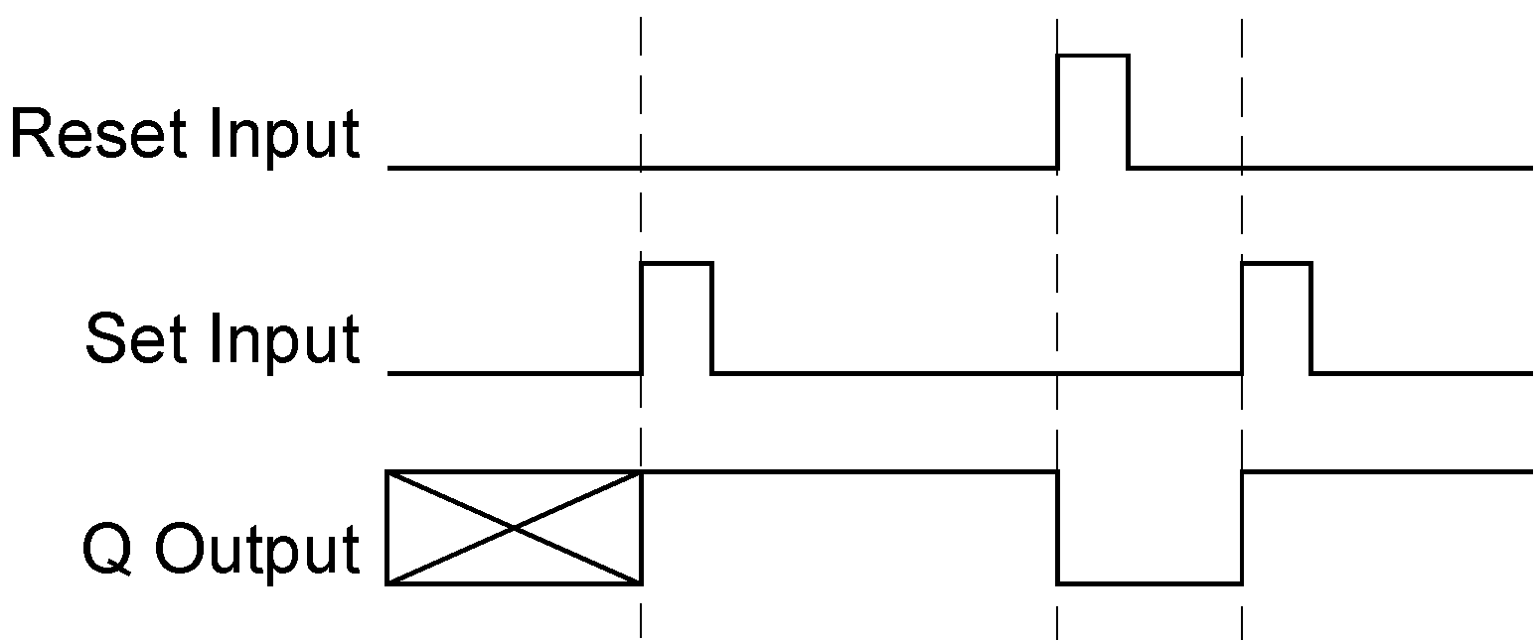
Timing For R-S Flip-Flop
Any pulse on the SET input will ensure that the Q output is at a logic '1’.
Any Pulse on the RESET input will ensure that the Q output is at a logic '0‘.
6. Race Hazard
7. An Interesting Circuit
8. Simple Memory Block
9. Timing For R-S Flip-Flop

Slide 19
R-S Flip-Flop Truth Table
Applying a pulse to both ‘Set’ and ‘Reset’ should never occur.
Therefore, this is not defined in the truth table
Note: n = time, n + 1 = time plus 1 (i.e. ‘Next’)
S | R | Q | Q’
0 | 0 | Q | Q’
1 | 0 | 1 | 0
0 | 1 | 0 | 1
1 | 1 | X | X
9. Timing For R-S Flip-Flop
9.1 R-S Flip-Flop Truth Table
9.2 More Practical Memory
9.3 Clocked R-S Flip-Flop
9.4 Memory Input

Slide 20
More Practical Memory
The R-S Flip-Flop does not offer a very practical memory.
It changes whenever the R or the S input is pulsed.
In a larger circuit, we need to synchronize the changes on the output.
9. Timing For R-S Flip-Flop
9.1 R-S Flip-Flop Truth Table
9.2 More Practical Memory
9.3 Clocked R-S Flip-Flop
9.4 Memory Input

Slide 21
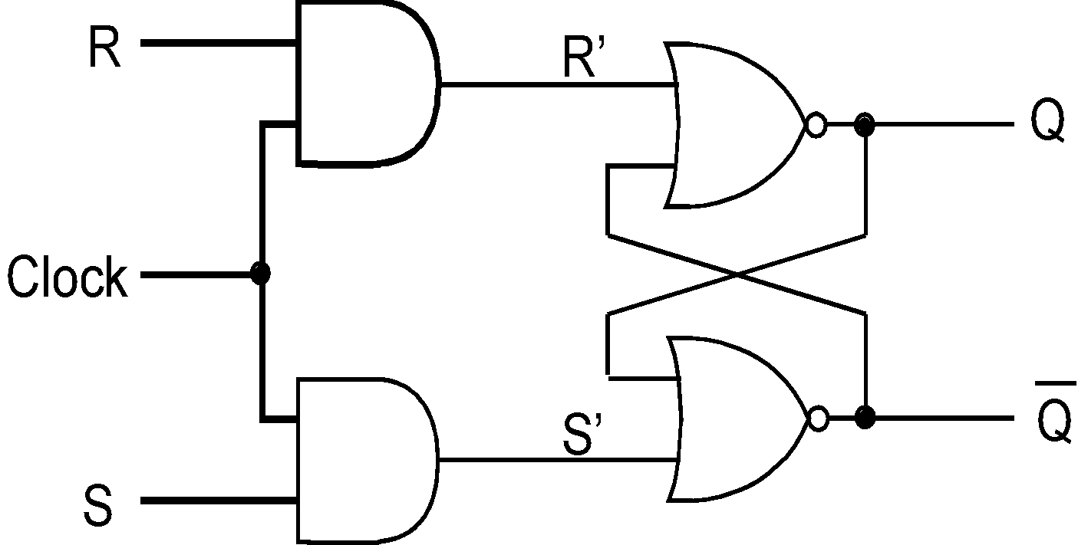
Clocked R-S Flip-Flop
9. Timing For R-S Flip-Flop
9.1 R-S Flip-Flop Truth Table
9.2 More Practical Memory
9.3 Clocked R-S Flip-Flop
9.4 Memory Input
Changes are synchronized by the clock signal. R or S signal will only move to the flip flop when the clock pulse is high.

Slide 22
Memory Input
9. Timing For R-S Flip-Flop
9.1 R-S Flip-Flop Truth Table
9.2 More Practical Memory
9.3 Clocked R-S Flip-Flop
9.4 Memory Input
Having 2 separate lines, Set and Reset, to store 1 bit of memory is inconvenient.
To use the memory on a CPU data bus, we much rather use one input to store the 1 bit.

Slide 23
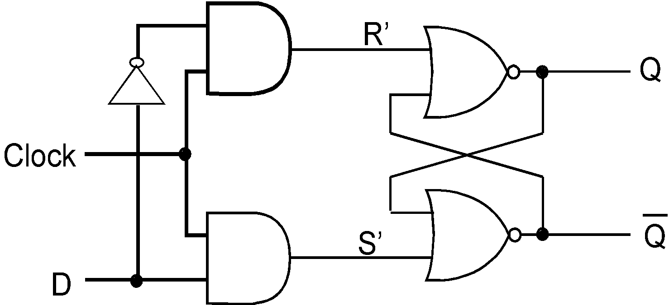
D-type Flip-Flop
10. D-type Flip-Flop
10.1 D-type Flip-Flop(rising-edge clock)
10.2 D-type Flip-Flop(falling edge clock)
Input D is transferred to output Q. If D (for data) is 1, what gets stored at Q? And if D is 0?

Slide 24
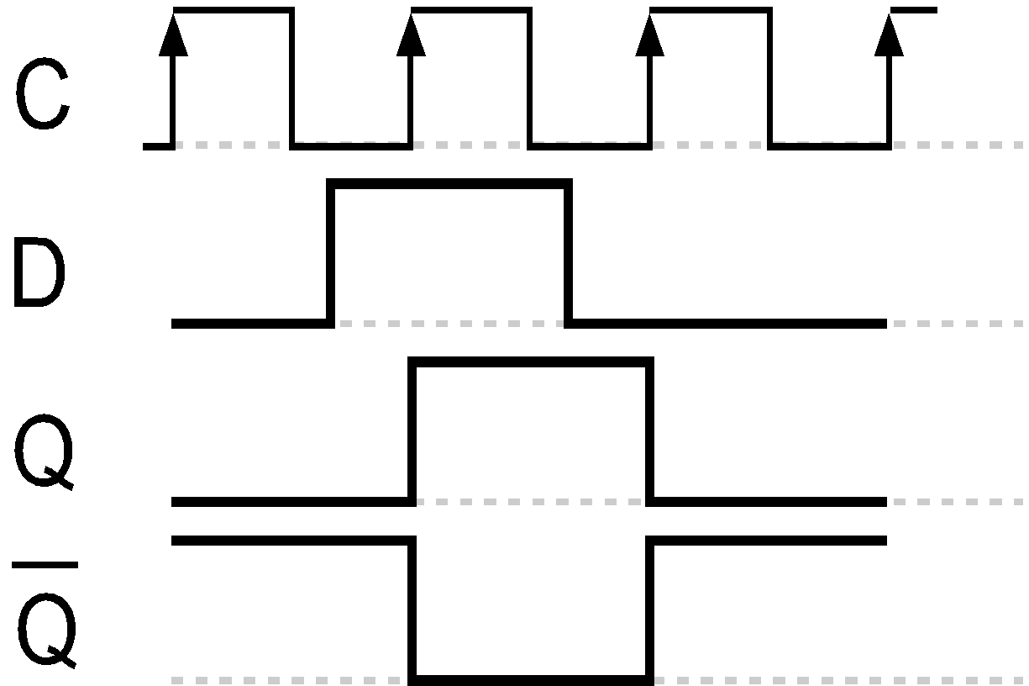
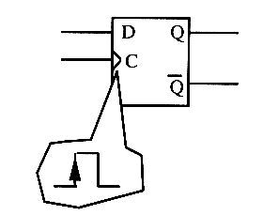
D-type Flip-Flop (rising edge clock)
10. D-type Flip-Flop
10.1 D-type Flip-Flop(rising-edge clock)
10.2 D-type Flip-Flop(falling edge clock)
Clock C transfers data D to Q on the rising edge of pulse.
Timing Diagram

Slide 25
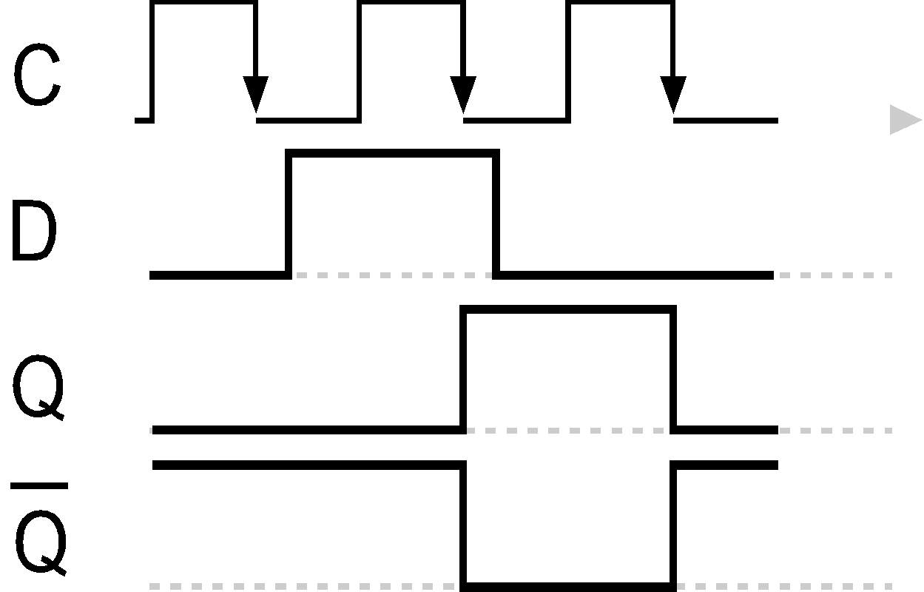
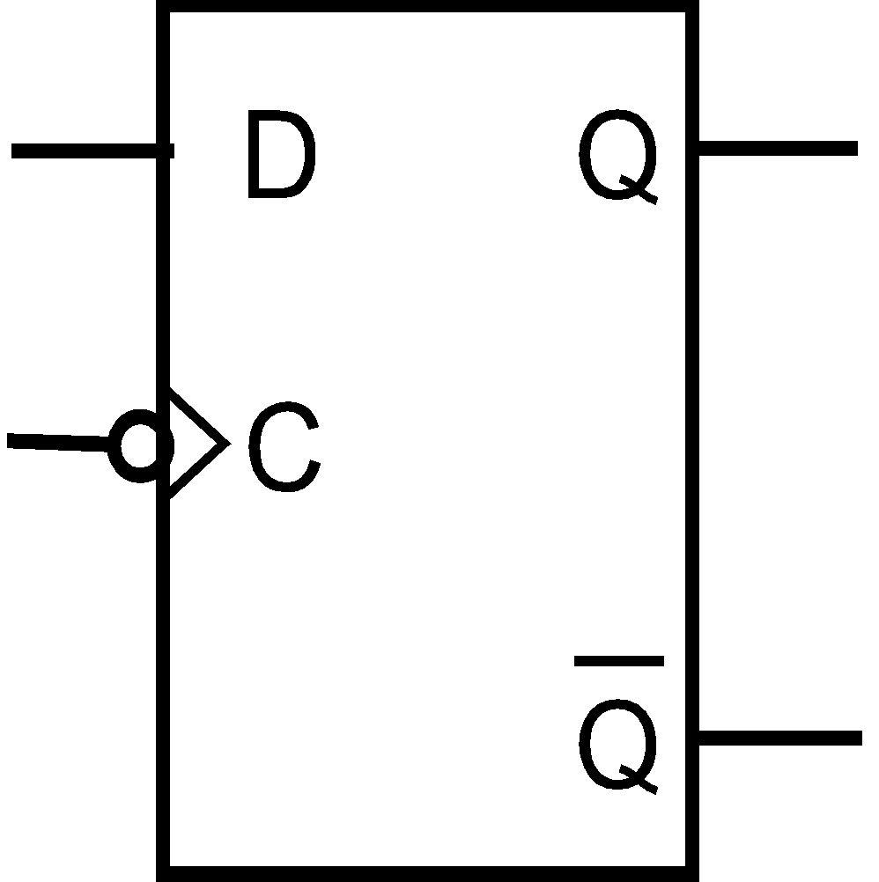
D-type Flip-Flop (falling edge clock)
10. D-type Flip-Flop
10.1 D-type Flip-Flop(rising-edge clock)
10.2 D-type Flip-Flop(falling edge clock)
inverter
Clock C transfers data D to Q on the falling edge of pulse.
Timing Diagram

Slide 26
More…….
More about different kind of memory in workshop…

Slide 27
Summary
Timing diagrams, pulses and clocks
Logic feedback, simple memory, RS Flip-flops
Clocked memory, D-type Flip-flops
11. Summary

Slide 28

Thank you…

